Slide 1
Fastq format & Trimming
Thomas Nordahl Petersen

Slide 2
Fasta vs fastq
A header line starting with ‘>’
String after ‘>’ is the name of the sequence
All lines until next ‘>’ are part of a sequence
>sequence1 description
ACNGTGTTTTTAGTTATTGTTTTGTTAAGTTGGGTTTTTTGTACCCAATAGCCAACAAGCCGCCTTTATGGCGGTTTTTTTGTGCCTGAAAAGTGGGCGCA
ACGTTAGCAGAATCGCTTTCTGTTCGTTTTCCACCTGCGACAGACGCACCGGACCACGGTTGGCGAGATCGTCGCGCAGAATATCGGCGGCACGCTGCGAC
>sequence2 some title
AGCGTCTGACTCACACAAAAACGGTAACACAGTTATCCACAGAATCAGGGGATAAGGCCGGAAAGAACATGTGAGCAAAAAGGCAAAGCCAGGACAAAAGG
CCCCCTGTCTAAAATATATAGCGCTTTGGGATATCGTAGCTTATGGGGGTATTTTTTAA

Slide 3
Fasta + quality scores = fastq
@J00138:63:HCNWCBBXX:5:1101:18802:1121 1:N:0:NAGATC
NGAAAAACAATCTCTCCAGTAGGTTTTTTTGCACAACGTTCATTCACTGCCATACAGGCAGCTTAGAAATGATCGCTTTTATCTTCAATACCTAA
+
#AAFFJJJJJJJJJJJJJJJJJJJJJJJJJJJJJJJJJJJJJ-FJJJJJJJJJJJJJJJJJJJJJJJJJJJJJJJJJFJJJJJJJJJJJJJJJJJ
Line 1 header: begins with a '@' character and is followed by a sequence identifier
Line 2 is the raw sequence letters.
Line 3 begins with a '+’ (optionally followed by the same sequence identifier.
Line 4 encodes the quality values for the sequence in Line 2
J001138 | Unique instrument name
63 | Run id
HCNWCBBXX | Flowcell id
5 | Flowcell lane number
1101 | Tile number within flowcell lane
18802 | ‘x’-coordinate within tile
1121 | ‘y’-coordinate within tile
1 | The member of a pair (paired-end or mate pair reads only)
N | Y if the read is filtered (did not pass), N otherwise
0 | 0 when none of the control bits are on, otherwise it is an even number
NAGATC | Index sequence/barcode
Notes:
----- Meeting Notes (10/2/13 14:19) -----
When the sequencing is done, you get your output…
----- Meeting Notes (10/2/13 14:27) -----
In this next section I will gow throug the output data.
The sequence data is outputtet as fastq files.
And what is fastq files?
It is a fasta file with quality scores!
So this is an example of a fastq file.

Slide 4
Fastq quality scores
@J00138:63:HCNWCBBXX:5:1101:18802:1121 1:N:0:NAGATC
NGAAAAACAATCTCTCCAGTAGGTTTTTTTGCACAACGTTCATTCACTGCCATACAGGCAGCTTAGAAATGATCGCTTTTATCTTCAATACCTAA
+
#AAFFJJJJJJJJJJJJJJJJJJJJJJJJJJJJJJJJJJJJJ-FJJJJJJJJJJJJJJJJJJJJJJJJJJJJJJJJJFJJJJJJJJJJJJJJJJJ
Ascii characters are encoded phred scores – now all 33 base (base 64 old)
Quality scores (Q) are Phred scores
Q = ascii value – 33
P=error rate = 10 ^{–Q/10} (probability that a base is incorrectly called)
Q = -10 log₁₀(P)
Question: P=0.001, What is Q?
Notes:
----- Meeting Notes (10/2/13 14:19) -----
When the sequencing is done, you get your output…
----- Meeting Notes (10/2/13 14:27) -----
In this next section I will gow throug the output data.
The sequence data is outputtet as fastq files.
And what is fastq files?
It is a fasta file with quality scores!
So this is an example of a fastq file.

Slide 5
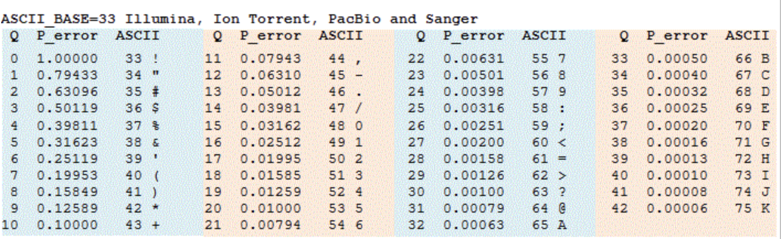
Fastq quality scores
@J00138:63:HCNWCBBXX:5:1101:18802:1121 1:N:0:NAGATC
NGAAAAACAATCTCTCCAGTAGGTTTTTTTGCACAACGTTCATTCACTGCCATACAGGCAGCTTAGAAATGATCGCTTTTATCTTCAATACCTAA
+
#AAFFJJJJJJJJJJJJJJJJJJJJJJJJJJJJJJJJJJJJJ-FJJJJJJJJJJJJJJJJJJJJJJJJJJJJJJJJJFJJJJJJJJJJJJJJJJJ
‘@’ which is the first character in header line is also used as a quality score
Ascii @ = 64, Q=31
Question: What is the first ascii character representing an error_rate <= 0.01?
Notes:
----- Meeting Notes (10/2/13 14:19) -----
When the sequencing is done, you get your output…
----- Meeting Notes (10/2/13 14:27) -----
In this next section I will gow throug the output data.
The sequence data is outputtet as fastq files.
And what is fastq files?
It is a fasta file with quality scores!
So this is an example of a fastq file.

Slide 6

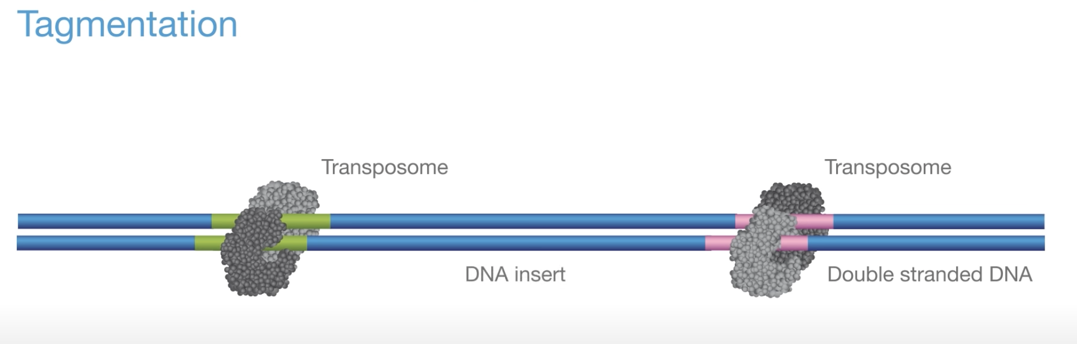
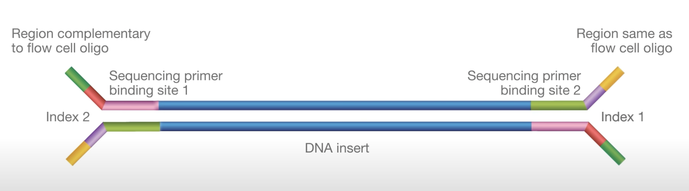
Sequence preparation
Single & paired-end sequencing
https://www.youtube.com/watch?v=womKfikWlxM

Slide 7
Fragment length
Insert size
150bp
Forward strand (F, 1 ,R1)
DNA Insert (size: 5’ – 5’)
Reverse strand (R, 2, R2)
1)
2)
3)
5’
3’
~320bp (our settings)
3’
5’

Slide 8
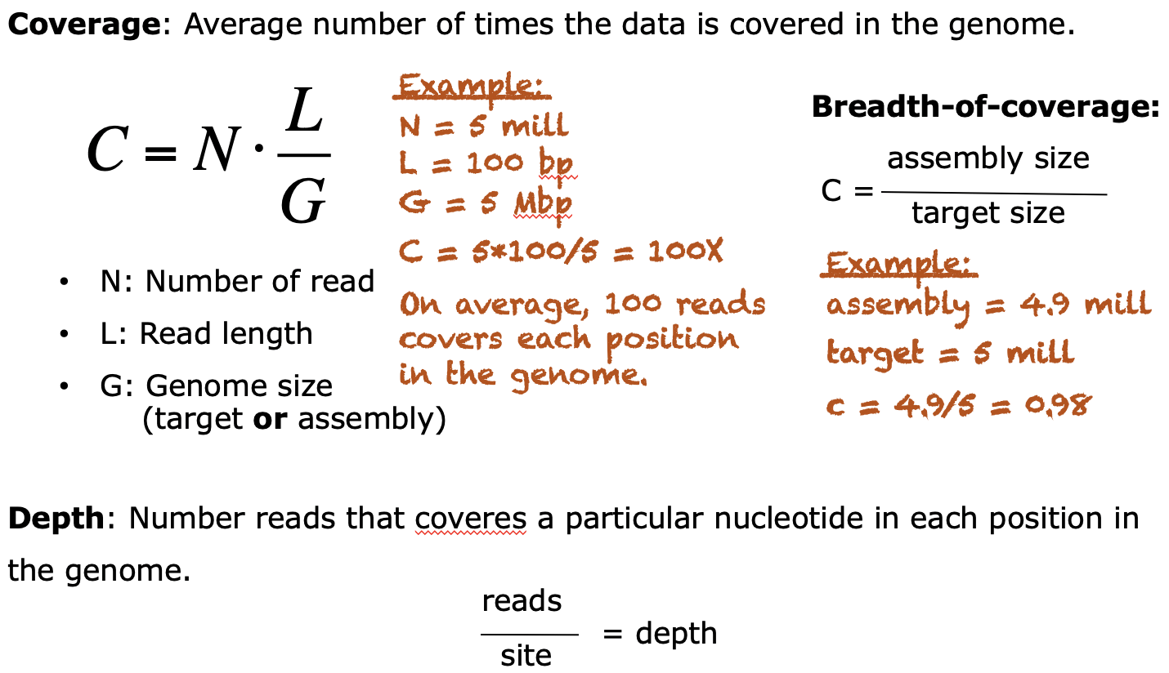
Coverage & depth
Reference

Slide 9
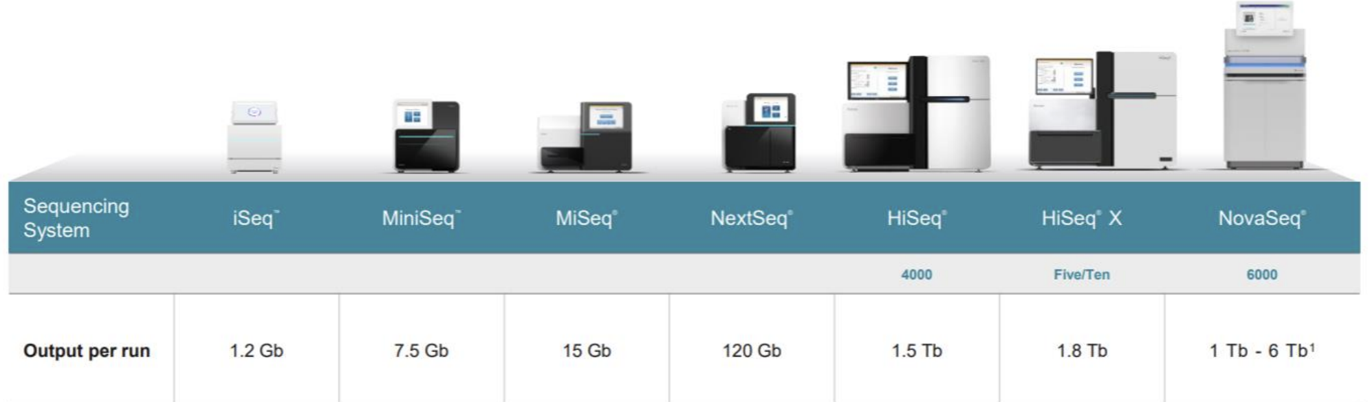
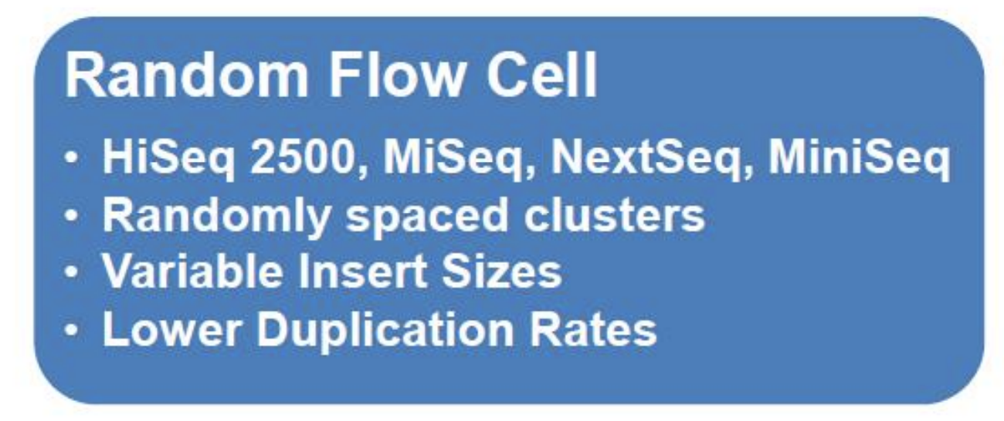
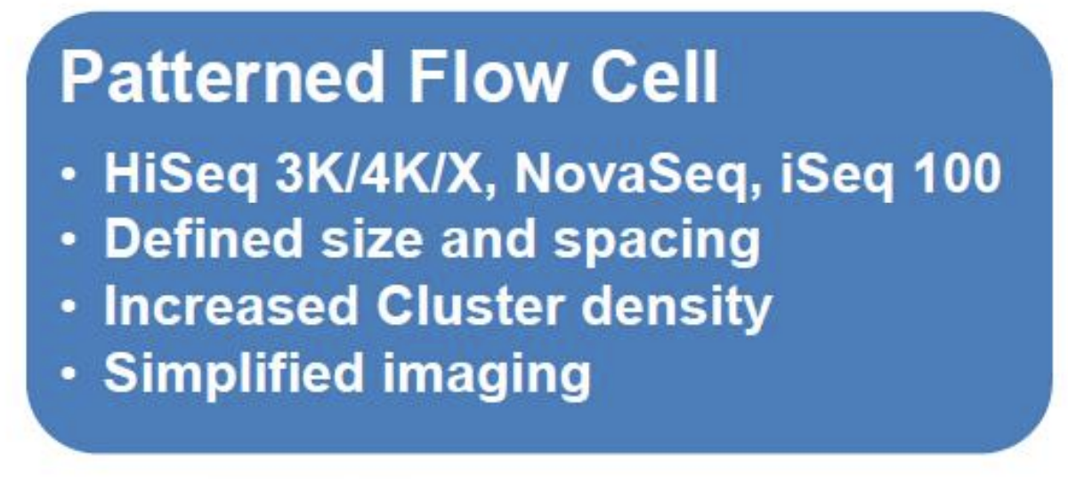
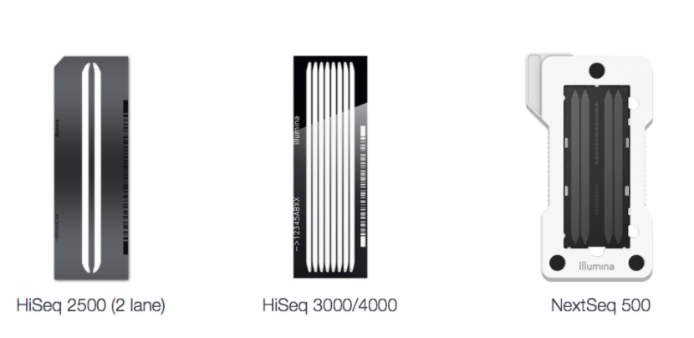
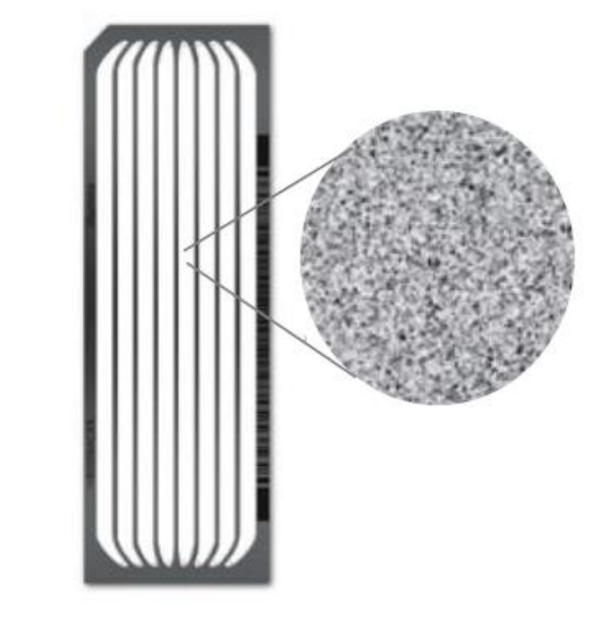
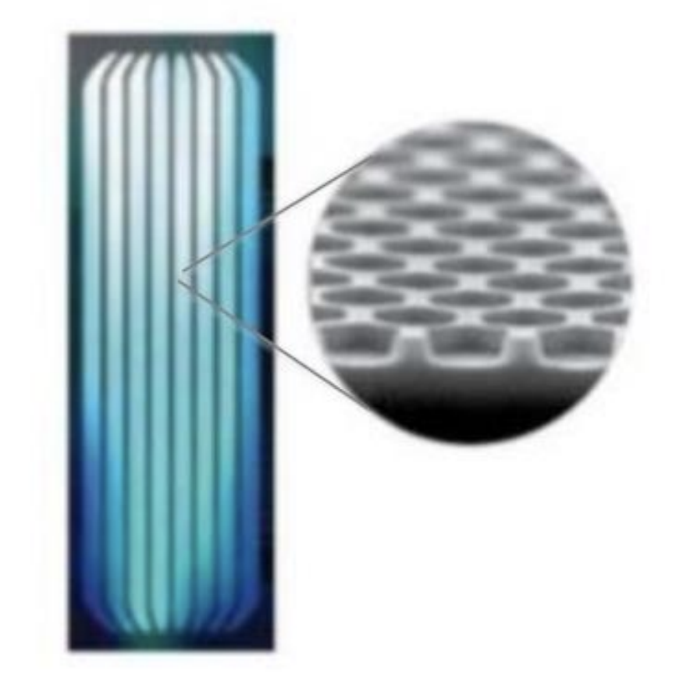
Sequencing
Output & flowcells

Slide 10
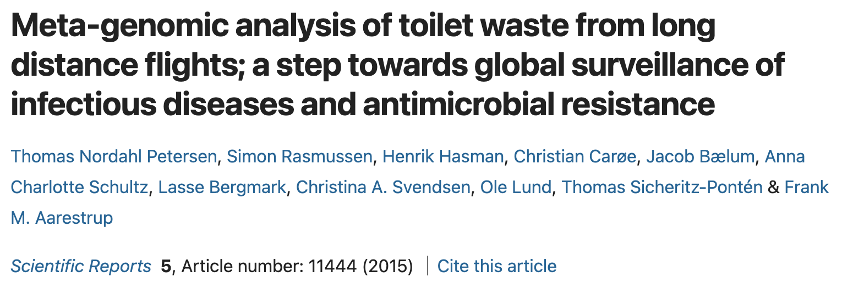
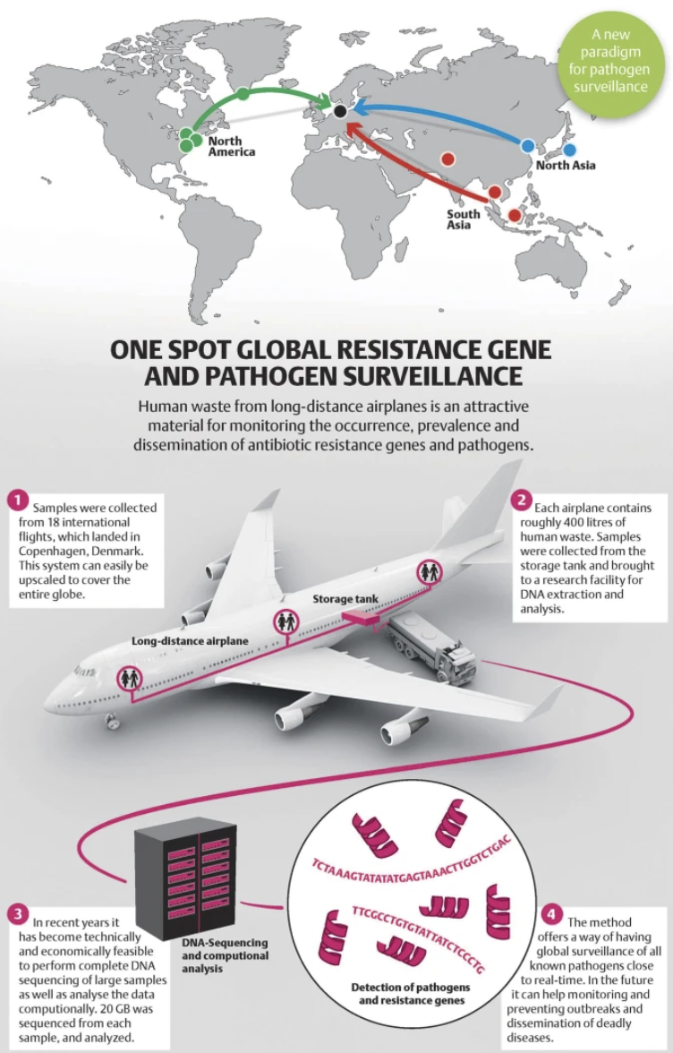
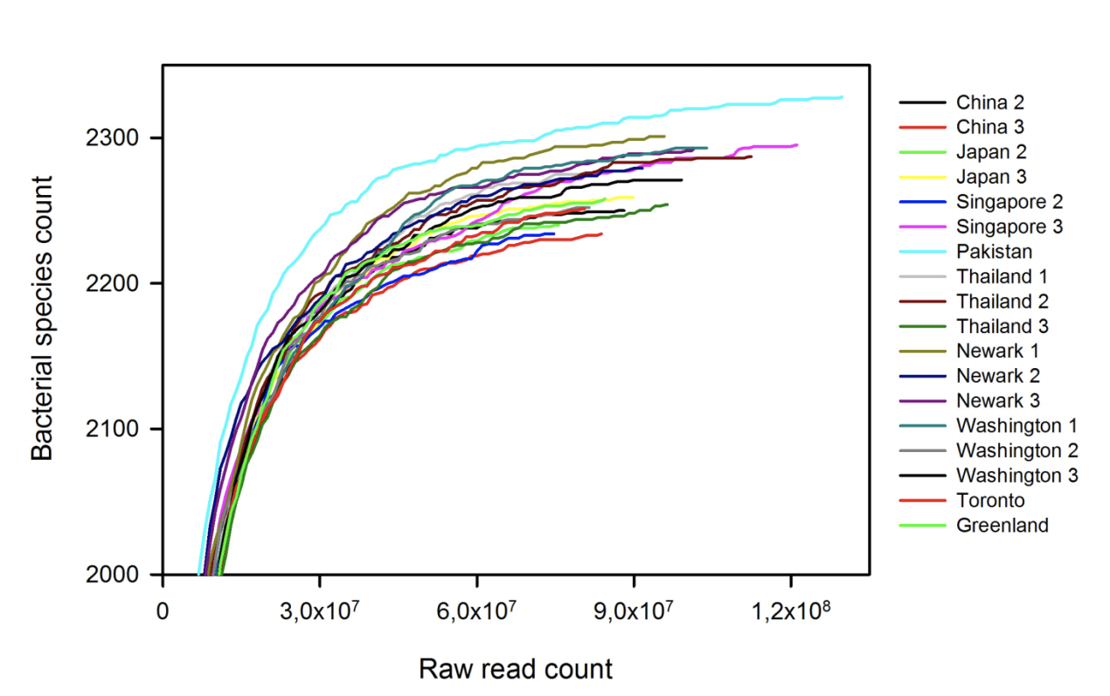
Rarefaction curve

Slide 11
De-multiplexing
Separating data from multiple samples
If only 1 physical sample is sequenced
1 fastq file, all reads from 1 sample
2 or more samples on same flowcell (China & Japan samples)
1 fastq file, where barcode in header can be used to de-multiplex
GAGATTCC
@A00197:28:H5NX:1:1101:2971:1000 1:N:0:GAGATTCC
CTTTTTTTTACGCCAAGTAATGGGGATGCACGATGCAAAGCATGTATTTTT+
FFFFFFFFFFFFFFFFFFF8FFFFFFFFFFFFFFFFFFFFFFFFFFFF???
@A00197:28:H5NX:1:1101:11541:1000 1:N:0:CCCGTAG
NGAAGAAGAAGAAGAAGAAGAAGAAGAAGAAGAAGAAGAAGAAGAAGAAGA
+
#8FFFFFFFFFFFFFFFFFFFFFFFFFFFFFHHHHHHIHHIFFFFFF@???
China
@A00197:28:H5NX:1:1101:2971:1000 1:N:0:GAGATTCC
CTTTTTTTTACGCCAAGTAATGGGGATGCACGATGCAAAGCATGTATTTTT+
FFFFFFFFFFFFFFFFFFF8FFFFFFFFFFFFFFFFFFFFFFFFFFFF???
CCCGTAG
@A00197:28:H5NX:1:1101:11541:1000 1:N:0:CCCGTAG
NGAAGAAGAAGAAGAAGAAGAAGAAGAAGAAGAAGAAGAAGAAGAAGAAGA
+
#8FFFFFFFFFFFFFFFFFFFFFFFFFFFFFHHHHHHIHHIFFFFFF@???
Japan

Slide 12
Splitting & clipping data
using barcodes aka multiplexing
Now De-multiplexing is usually done by the sequencer
Fastq example:
@FCC0CD5ACXX:1:1101:1103:2048#ACCGT/1
ACNGTGTTTTTAGTTATTGTTTTGTTAAGTTGGGTTTTTTGTACCCAATAGCCAACAAGCCGCCTTTATGGCGGTTTTTTTGTGCCTGAAAAGTGGGCGC
+
_BP`ccceggcegihiiighiifhihfddgfhi^efgfhhhhhegiiiiiiiihiihihggeeccdddcccacWTT^acc[ab_`]`[_b`^BBBBBBBB
@FCC0CD5ACXX:1:1101:1165:2058#ACGTT/1
ACGTTAGCAGAATCGCTTTCTGTTCGTTTTCCACCTGCGACAGACGCACCGGACCACGGTTGGCGAGATCGTCGCGCAGAATATCGGCGGCACGCTGCGA
+
bb_eeceefeggehhdagfghhiihfghighhffhifhhcghfdhiihafgdceba`a\aaccc^V]^baccaccXaaX^bbcccaac[_X]]a[aacXT
@FCC0CD5ACXX:1:1101:1135:2082#AGCGT/1
AGCGTGACAAACATTTTATTGCGCCCGGTTTTATCCAGCTTGAATGCCTGACGAAAGAAGATGATGGTGACGACGATGGAGAGAACAATCAGCACCAGAT
+
bbbeeeeefggfgiihgiigiiiiiiiffgifgeghiiihhfefffhhhfgh_fhggdgegeaceeacbdcbcc\^aa]``_^bb]bcccccbac_a^bc
@FCC0CD5ACXX:1:1101:1239:2083#AGCGT/1
AGCGTCTGACTCACACAAAAACGGTAACACAGTTATCCACAGAATCAGGGGATAAGGCCGGAAAGAACATGTGAGCAAAAAGGCAAAGCCAGGACAAAAG
+
bbbeeeeegggggiiiiiiiiiigifhhiiighiiihhiiiiiiihiiiiiiiiiihiigcdbbdcdcccccdccccccccacccccccbcccacccccc

Slide 13
Fastqc & trimming
Why do we want to trim?
A
DNA insert
ATTTCCGCGT
Errors in called nucleotides
Incorrect Single Nucleotide Polymorphisms (SNPs)
Maybe a low Phred score
Bad assemblies once reads are assembled to contigs
Regions that are not from the original source DNA
adaptors

Slide 14
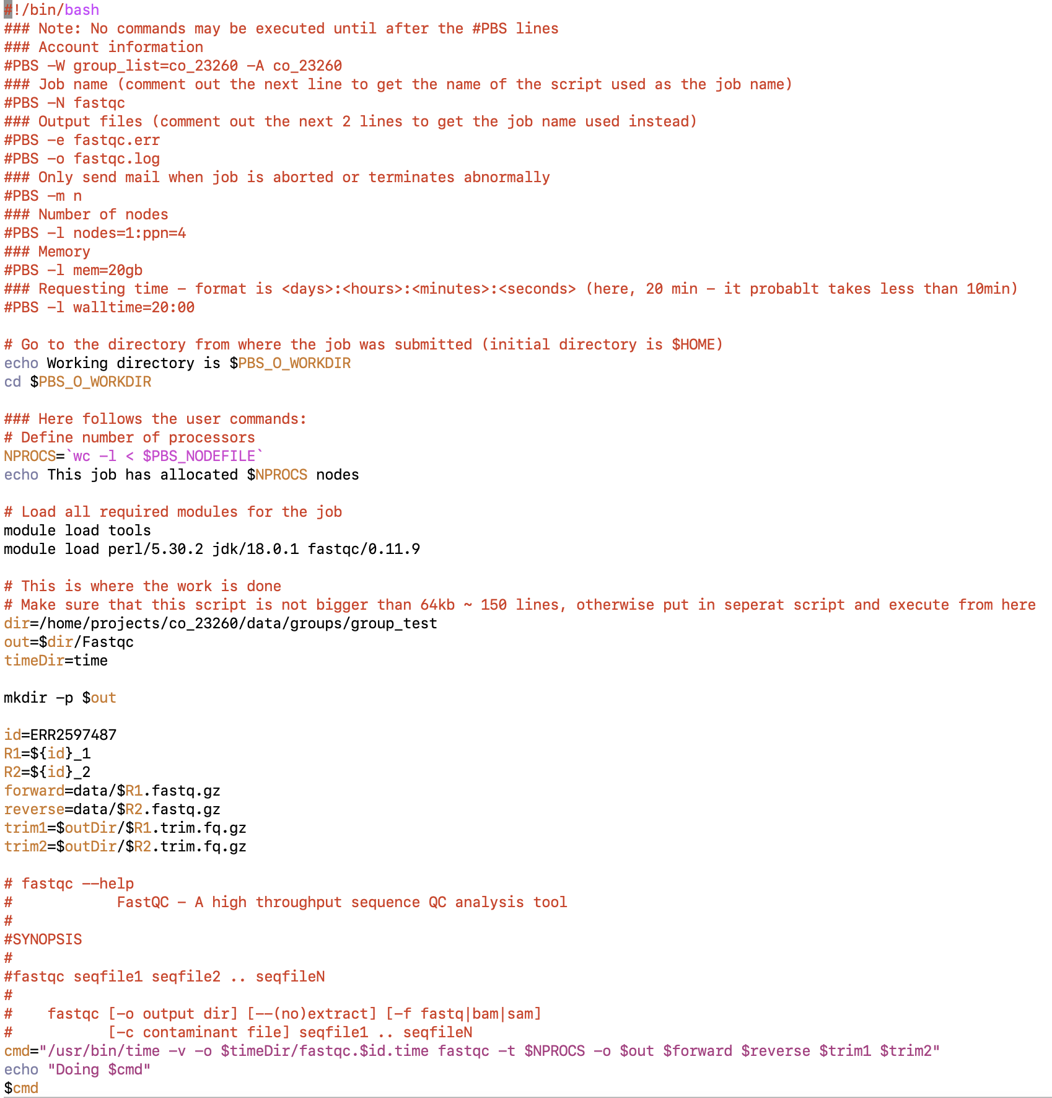
FastQC
FastQC - A high throughput sequence QC analysis tool

Slide 15
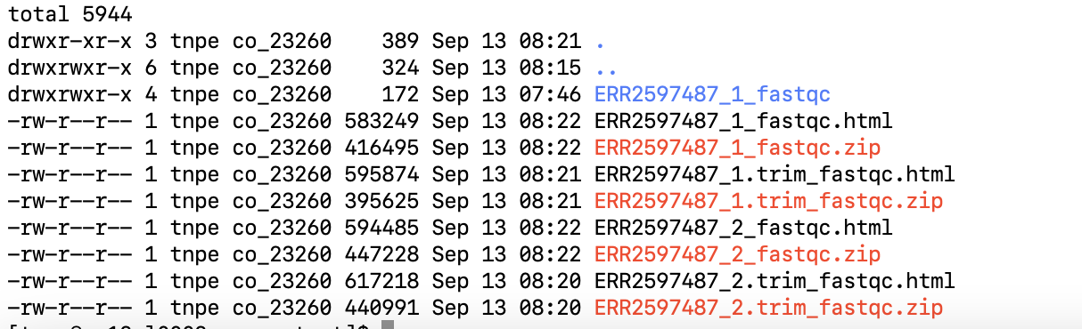
FastQC
FastQC - A high throughput sequence QC analysis tool
How to view html file – easiest to mail files to yourself
echo ”” | mail -s ”subject" –a file1 -a file2 s12345@dtu.dk
Ex:
echo ”” | mail -s ” ERR2597487_1" –a ERR2597487_1_fastqc.html tnpe@food.dtu.dk

Slide 16
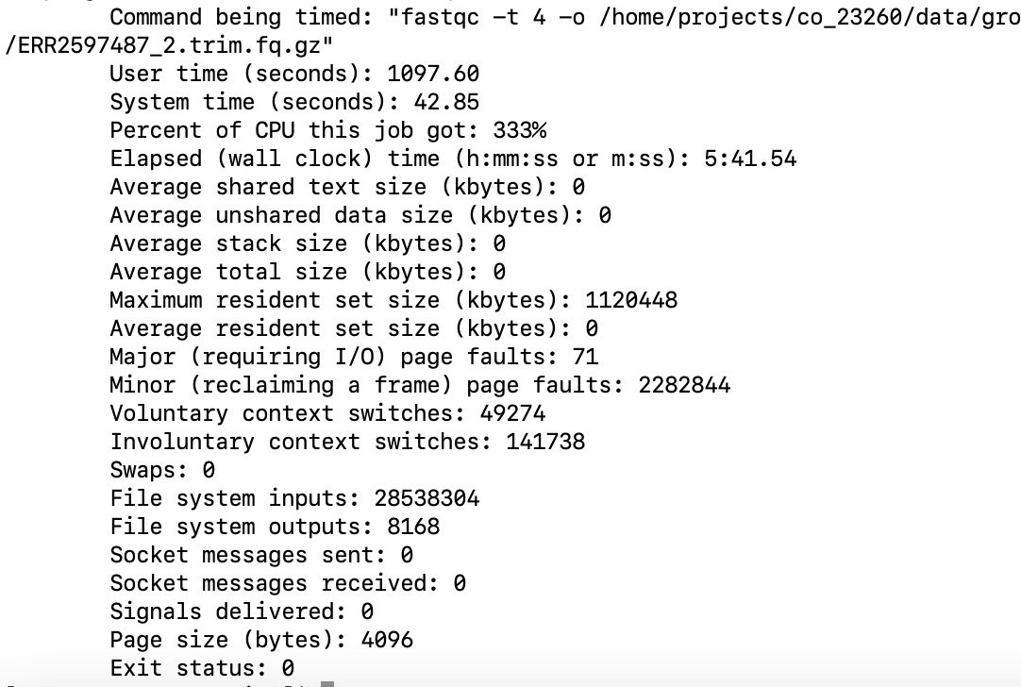
FastQC (time)
FastQC - A high throughput sequence QC analysis tool

Slide 17
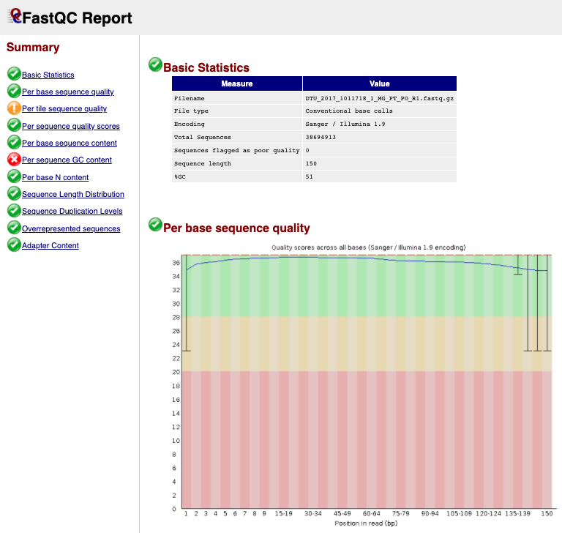
Data quality

Slide 18
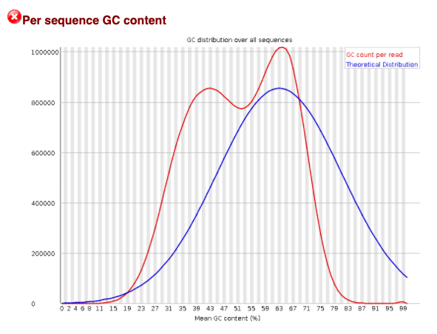
Data quality

Slide 19
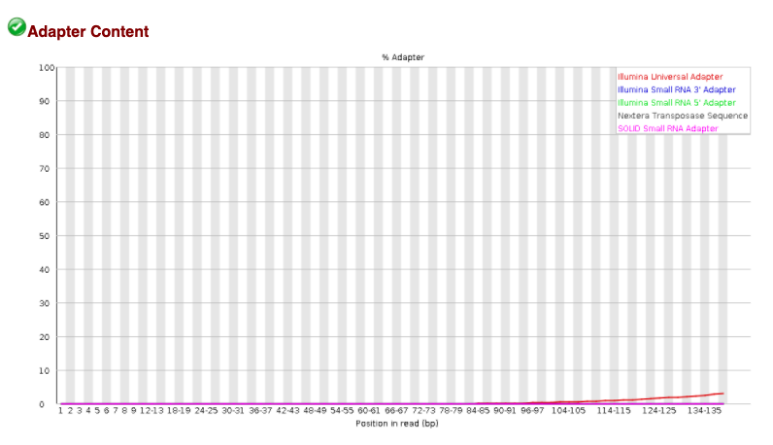
Data quality
Before trimming

Slide 20
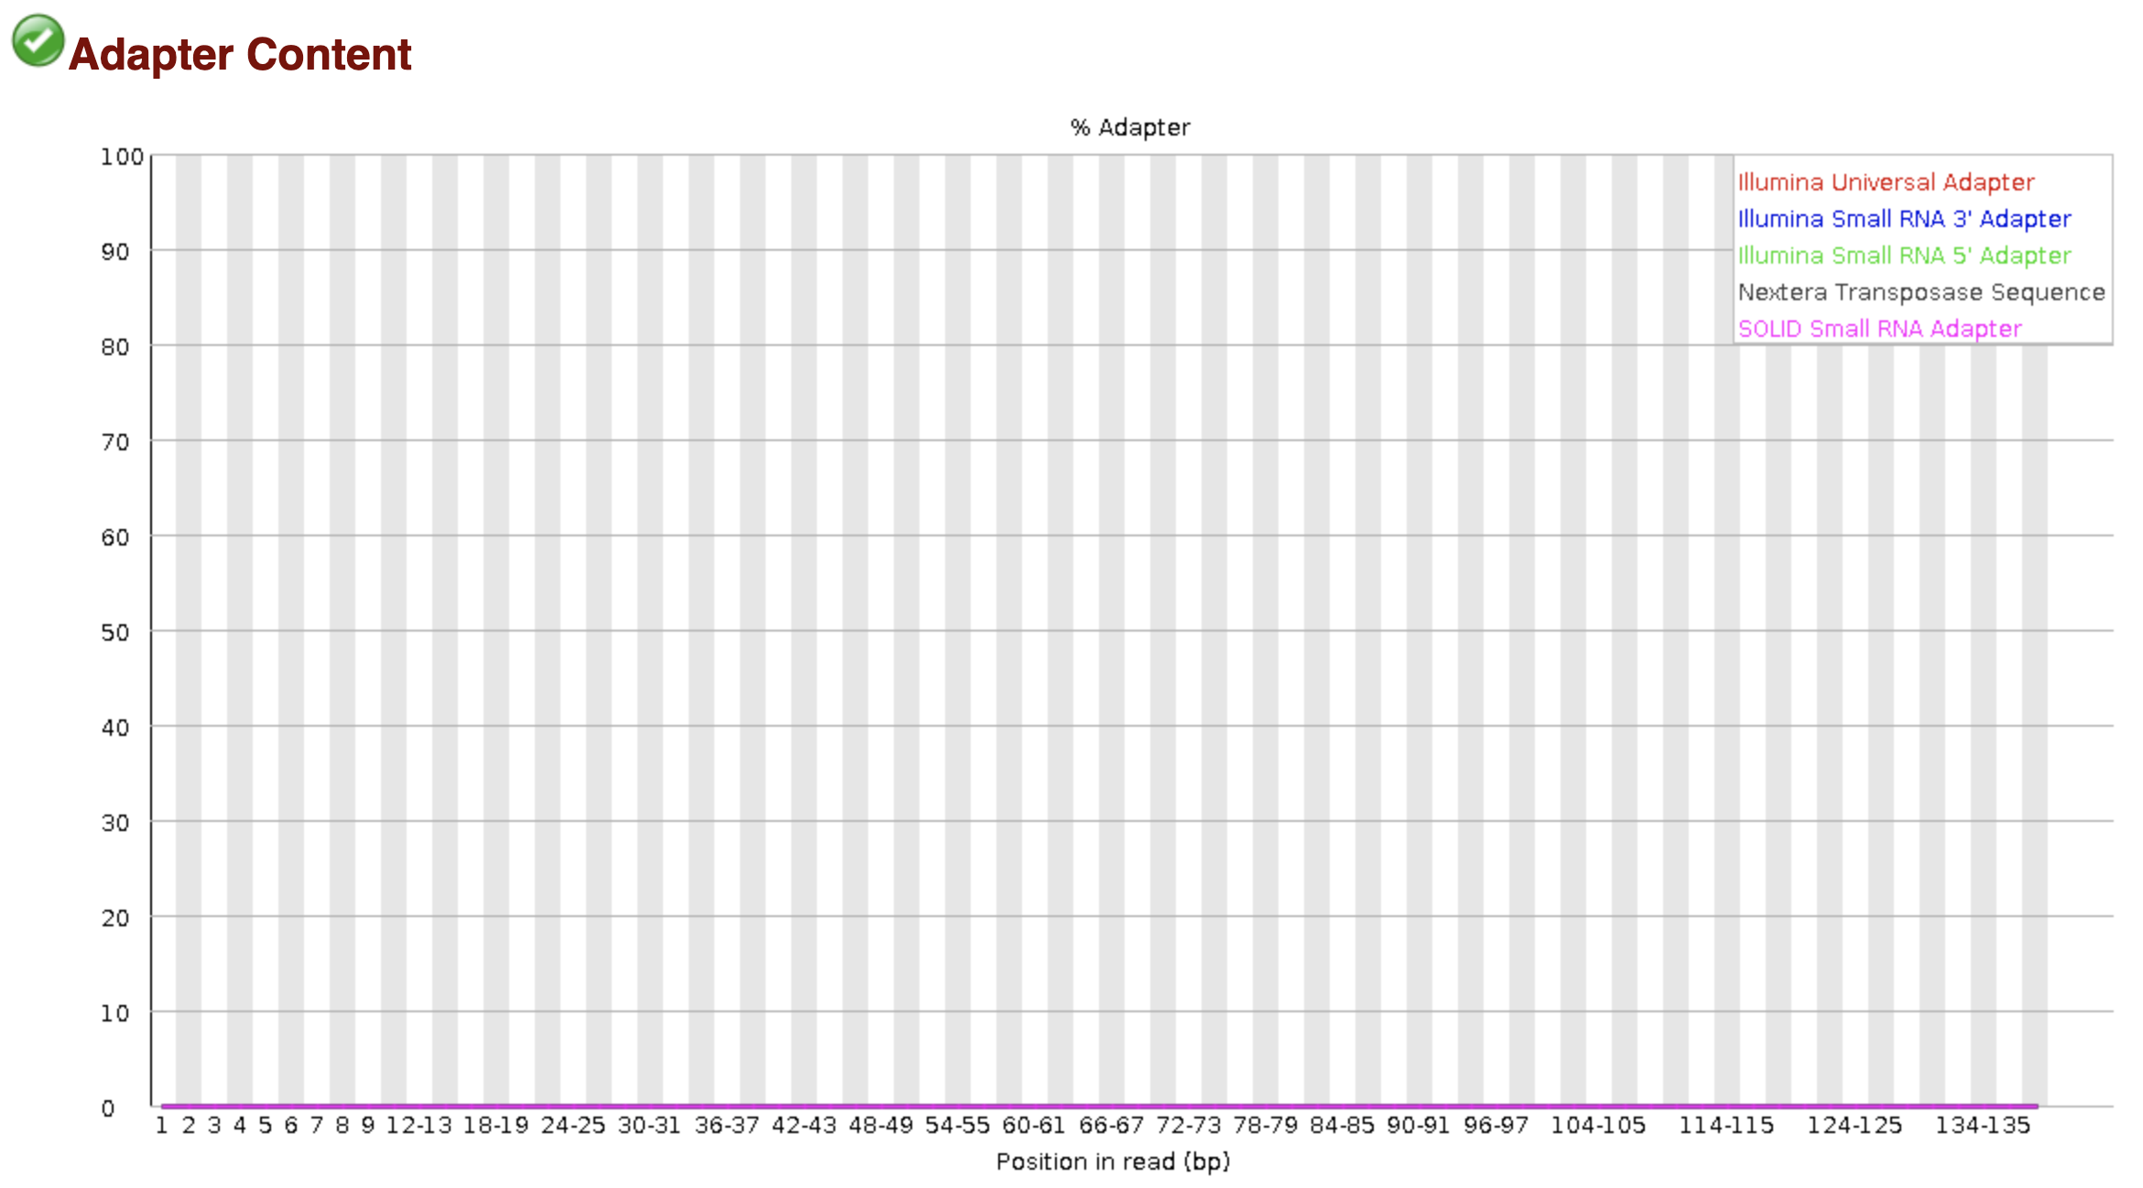
Data quality
After trimming

Slide 21
Trimming next
Break 15 min

Slide 22
Trimming
What should a trimmer do
Some trimming programs have MAAANY parameters to set. The three primary issues that they have to deal with are:
Trim regions that include adaptor regions
Trim regions that have low phred scores
Completely remove reads that become too short
Name | year | Citations | url
cutadapt | 2011 | 12944
Trimmomatic | 2014 | 25976 | https://doi.org/10.1093/bioinformatics/btu170
Bbduk.sh | Not published |  | https://jgi.doe.gov/data-and-tools/bbtools/bb-tools-user-guide/
fastp | 2018 | 1922 | 10.1093/bioinformatics/bty560

Slide 23
Trimming data
Fastq example:
@FCC0CD5ACXX:1:1101:1103:2048#ACCGT/1
ACNGTGTTTTTAGTTATTGTTTTGTTAAGTTGGGTTTTTTGTACCCAATAGCCAACAAGCCGCCTTTATGGCGGTTTTTTGTGCCTGAAAAGTGGGCGCA
+
_BP`ccceggcegihiiighiifhihfddgfhi^efgfhhhhhegiiiiiiiihiihihggeeccdddcccacWTT^acc[ab_`]`[_b`^BBBBBBBB
@FCC0CD5ACXX:1:1101:1165:2058#ACGTT/1
ACGTTAGCAGAATCGCTTTCTGTTCGTTTTCCACCTGCGACAGACGCACCGGACCACGGTTGGCGAGATCGTCGCGCAGAATATCGGCGGCACGCTGCGAC
+
bb_eeceefeggehhdagfghhiihfghighhffhifhhcghfdhiihafgdceba`a\aaccc^V]^baccaccXaaacc[ab_`]`[_b`^BBBBBBBB
@FCC0CD5ACXX:1:1101:1135:2082#AGCGT/1
AGCGTGACAAACATTTTATTGCGCCCGGTTTTATCCAGCTTGAATGCCTGACGAAAGAAGATGATGGTGACGACGATGGAGAGAACAATCAGCACCAGATT
+
bbbeeeeefggfgiihgiigiiiiiiiffgifgeghiiihhfefffhhhfgh_fhggdgegeaceeacbdcbcc\^aa]``_^bb]bcccccbac_a^bc
@FCC0CD5ACXX:1:1101:1239:2083#AGCGT/1
AGCGTCTGACTCACACAAAAACGGTAACACAGTTATCCACAGAATCAGGGGATAAGGCCGGAAAGAACATGTGAGCAAAAAGGCAAAGCCAGGACAAAAGG
+
bbbeeeeegggggiiiiiiiiiigifhhiiighiiihhiiiiiiihiiiiiiiiiihiigcdbbdcdcccccdccccccccacccccccbcccacccccc

Slide 24
Trimming with bbduk
K-trim
Identify & remove sequences using kmers
Adaptor sequences
Q-trim
Removing nucleotides with low quality scores (Q)
5’
3’
qtrim=l
qtrim=r

Slide 25
Q-trimming
trimq=20, qtrim=r, minlen=50
@A00197:28:H5N3GDMXX:1:1101:11541:1000 1:N:0:GAGATTCC+GTACTGAC
NGAAGAAGAAGAAGAAGAAGAAGAAGAAGAAGAAGAAGAAGAAGAAGAAGAAGAAGAAGAAGAAGAAGAAGAAGAAGAAGAAGAAGA
AGAAGAAGAAGAAGAAGAAGAAGAAGAAGAAGAAGAAGAAGAAGAAGACAAAAAAGATCAGAA
+
#8FFFFFFFFFFFFFFFFFFFFFFFFFFFFFFFFFFFFFFFFFFFFFFFFFFFFFFFFFFFFFFFFFFFFFFFFFFFFFFFF-FFFF
FFFFFFFFFFFFFFFFFFFFFFFFFFFFFFFFFFFFFF-F88FFF--F-FF8-FF-FF--88-

Slide 26
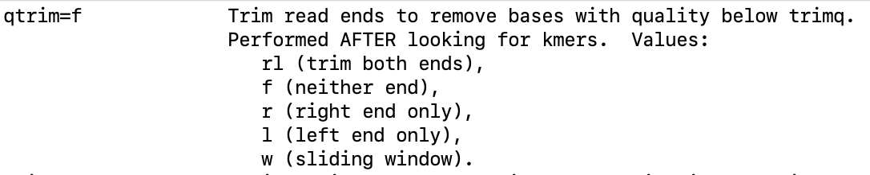
Q-trimming
Phred algorithm
Command: bbduk.sh in=in.fq out=out.fq --minlen=50 --trimq=20 --qtrim=r
Input:
@A00197:28:H5N3GDMXX:1:1101:11541:1000 1:N:0:GAGATTCC+GTACTGAC
NGAAGAAGAAGAAGAAGAAGAAGAAGAAGAAGAAGAAGAAGAAGAAGAAGAAGAAGAAGAAGAAGAAGAAGAAGAAGAAGAAGAAGA
AGAAGAAGAAGAAGAAGAAGAAGAAGAAGAAGAAGAAGAAGAAGAAGACAAAAAAGATCAGAA
+
#8FFFFFFFFFFFFFFFFFFFFFFFFFFFFFFFFFFFFFFFFFFFFFFFFFFFFFFFFFFFFFFFFFFFFFFFFFFFFFFFF-FFFF
FFFFFFFFFFFFFFFFFFFFFFFFFFFFFFFFFFFFFF-F88FFF--F-FF8-FF-FF--88-
Output: Q(F)=37, Q(8)=23, Q(-)=12
@A00197:28:H5N3GDMXX:1:1101:11541:1000 1:N:0:GAGATTCC+GTACTGAC
NGAAGAAGAAGAAGAAGAAGAAGAAGAAGAAGAAGAAGAAGAAGAAGAAGAAGAAGAAGAAGAAGAAGAAGAAGAAGAAGAAGAAGA
AGAAGAAGAAGAAGAAGAAGAAGAAGAAGAAGAAGAAGAAGAAGAAGACAAAAAAGATCAGAA
+
#8FFFFFFFFFFFFFFFFFFFFFFFFFFFFFFFFFFFFFFFFFFFFFFFFFFFFFFFFFFFFFFFFFFFFFFFFFFFFFFFF-FFFF
FFFFFFFFFFFFFFFFFFFFFFFFFFFFFFFFFFFFFF-F88FFF--F-FF8-FF-FF--88-

Slide 27
Q-trimming with bbduk
Bbduk.sh uses the phred algorithm to perform Quality trimming
Discarded region has an average quality < Q-threshold
Retained region has an average quality >= Q-threshold
Retained region cannot be extended without adding a subregion with average quality < Q-threshold
Retained region cannot be reduced without removing a subregion with average quality >= Q-threshold
Average quality is calculated by averaging error-rates P as Q scores are on log scale and can NOT be used
BBDuk actually does have an option for window-based trimming ("qtrim=window,5" for a 5-bp window) which is easier to understand but doesn't give optimal results.
We use Q-threshold Q=20 => P(20)=0.01

Slide 28
Q-trimming with bbduk
A: Ave error_rate_1
B: Ave error_rate_2
Bases with a quality below threshold
A <= threshold & B > threshold ?
Discarded region has an average quality < Q-threshold (i.e. average error_rate > threshold)
Retained region has an average quality >= Q-threshold
Retained region cannot be extended without adding a subregion with average quality < Q-threshold
Retained region cannot be reduced without removing a subregion with average quality >= Q-threshold

Slide 29
Q-trimming of fastq reads
Phred algorithm ex. threshold=0.01 (Q=20)
Nucleotides with q > 0.01
Nucleotides with q < 0.01
5’----------------------------------------3’
1)
Ave(P) > 0.01
Ave(P) >0.01
Ave(P) < 0.01
2)
Ave(P) >0.01
Ave(P) < 0.01
3)
Sub-region ave(P) > 0.01
4)
Sub-region ave(P)< 0.01
Therefore stop after 3)

Slide 30
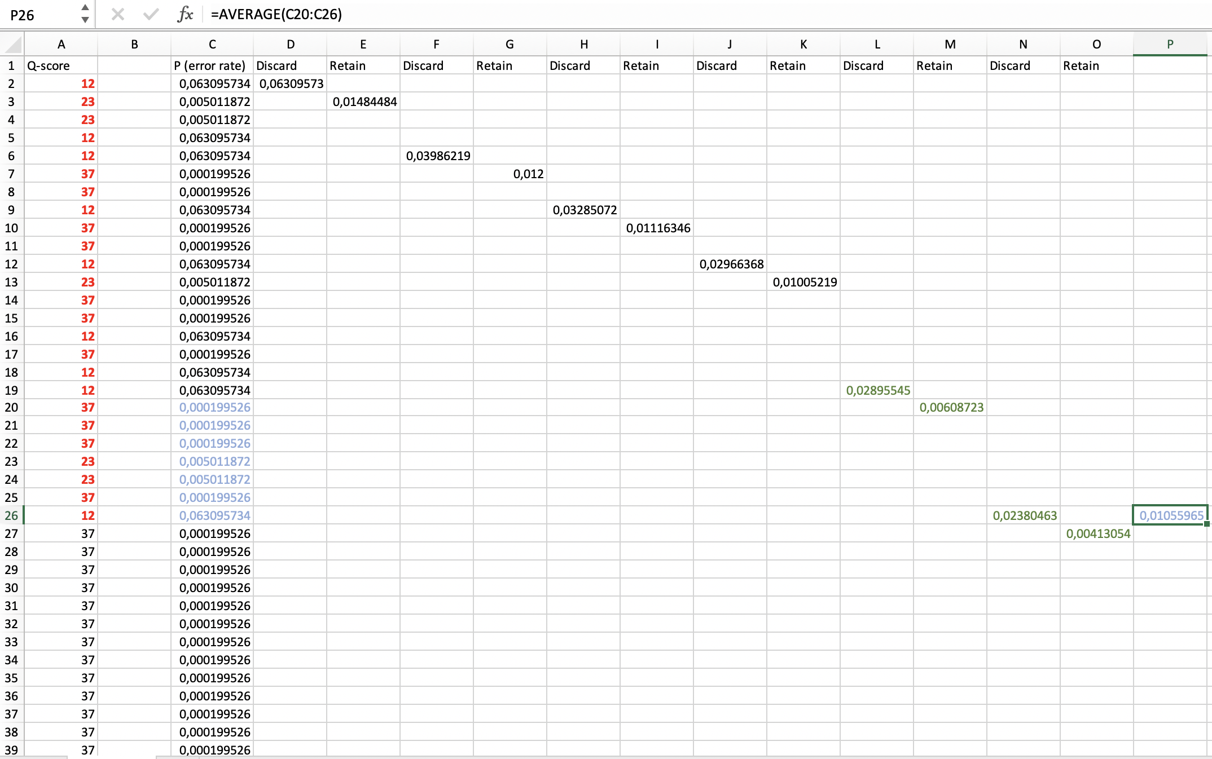
Q-trimming
Cutoff =0.01
Ave(P) of sub-region > 0.01 (in blue)
Optimal trimming
boundary

Slide 31
K-trimming
Adaptor removal using kmers
A kmer is a string of characters where k is the length of the kmer
ATGCATG (length 7bp) => 5 kmers, k=3
ATG
TGC
GCA
CAT
ATG
Kmers can be stored in programs
Python ”dictionaries”
Perl ”hash”
Very fast to lookup if a specific kmer is present in a sequence. Memory can be a problem.

Slide 32
K-trimming
Adaptor removal using kmers
/home/projects/co_23260/data/adaptors/adaptors.fa
>Illumina_Single_End_Apapter_1
ACACTCTTTCCCTACACGACGCTGTTCCATCT
>Illumina_Single_End_Apapter_2
CAAGCAGAAGACGGCATACGAGCTCTTCCGATCT
>Illumina_Single_End_PCR_Primer_1
AATGATACGGCGACCACCGAGATCTACACTCTTTCCCTACACGACGCTCTTCCGATCT
>Illumina_Single_End_PCR_Primer_2
CAAGCAGAAGACGGCATACGAGCTCTTCCGATCT
>Illumina_Single_End_Sequencing_Primer
ACACTCTTTCCCTACACGACGCTCTTCCGATCT
>Illumina_Paired_End_Adapter_1
ACACTCTTTCCCTACACGACGCTCTTCCGATCT

Slide 33
K-trimming
Adaptor removal using kmers
>Illumina_Single_End_Apapter_1 (Found in adaptor file)
ACACTCTTTCCCTACACGACGCTGTTCCATCT
Settings in bbduk (our thresholds)
k=19 (ACACTCTTTCCCTACACGA)
Mink=11 (ACACTCTTTCC)
@A00197:28:H5N3GDMXX:1:1220:19614:6872 1:N:0:GAGATTCC+GTACTGAC
CGGCGACCACCGAGATCTACACGTACTGACACACTCTTTCCCTACACGACGCACTTCCGATCAGTGCACCCTACCCATTTTCTTTGGATATAAAAGCTGGAATTGCGTGGCTGTAGGAGGCCGGGACATCCAAGTAGGCAGTGGGGATAT
+
-8FFF-FFF8FFFFFFF88FFF888F8F8FFFFF88FFFFFF8FFFFF8FFF8FF8FFF8FF88FF8F8F8-FF----FFFF---FF-FF---------F-FFF-F-F------------F---------------------F-F-----
--

Slide 34
K-trimming
Adaptor removal using kmers
Our setting in bbduk
k=19 (ACACTCTTTCCCTACACGA)
Mink=11 (ACACTCTTTCC) – allow for shorter kmers in ends
@A00197:28:H5N3GDMXX:1:1220:19614:6872 1:N:0:GAGATTCC+GTACTGAC
CGGCGACCACCGAGATCTACACGTACTGACACACTCTTTCCCTACACGAACTTCCGATCAGTGCACCCTACCCATTTTCTTTGGATATAAAAGCTGGAATTGCGTGGCTGTAGGAGGCCGGGACATCCAAGTAGGCAGTGGGGATA
@A00197:28:H5N3GDMXX:1:1220:19614:6872 1:N:0:GAGATTCC+GTACTGAC
CGGCGACCACCGAGATCTACACGTACTGACACACTCTTTCCCACTTCCGATCAGTGCACCCTACCCATTTTCTTTGGATATAAAAGCTGGAATTGCGTGGCTGTAGGAGGCCGGGACATCCAAGTAGGCAGTGGGGATAT
@A00197:28:H5N3GDMXX:1:1220:19614:6872 1:N:0:GAGATTCC+GTACTGAC
CGGCGACCACCGAGATCTACACGTACTGACTTCCGATCAGTGCACCCTACCCATTTTCTTTGGATATAAAAGCTGGAATTGCGTGGCTGTAGGAGGCCGGGACATCCAAGTAGGCAGTGGGGATATACACACTCTTTCCC
@A00197:28:H5N3GDMXX:1:1220:19614:6872 1:N:0:GAGATTCC+GTACTGAC
CGGCGACCACCGAGATCTACACGTACTGACACACTCTTTCCCTACACGAACTTCCGATCAGTGCACCCTACCCATTTTCTTTGGATATAAAAGCTGGAATTGCGTGGCTGTAGGAGGCCGGGACATCCAAGTAGGCAGTGGGGATA
Trimmed
Not trimmed
Trimmed
Not trimmed

Slide 35
K-trimming
Adaptor removal using kmers
Hamming distance (hdist) is the number of edits to make 2 sequences identical
Sequence (k=3, hdist=0): ATGC
Kmers: ATG TGC
Hdist=1 (expanding kmer=ATG)
ATG TTG CTG GTG
ATG AAG ACG AGG
ATG ATA ATC ATG
Number of kmers: 4k^{hdist}
hdist > 0 => more memory requirements to store all new kmers

Slide 36
K-trimming
Identifying short adaptors by overlap
You can not identify short terminal adaptors that are shorter than your kmer length (with hamming distance=0)
Only when insert size is shorter than read length
@A00197:28:H5N3GDMXX:1:1220:19614:6872 1:N:0:GAGATTCC+GTACTGAC
CGGCGACCACCGAGATCTACACGTACTGACTTCCGATCAGTGCACCCTACCCATTTTCTTTGGATATAAAAGCTGGAATTGCGTGGCTGTAGGAGGCCGGGACATCCAAGTAGGCAGTGGGGATATACACACTCTTTCCC
10bp
Aligned by overlap

Slide 37
After trimming with bbduk
File.R1.trim.fq.gz & File.R2.trim.fq.gz (in sync)
File.R1.singletons.fq.gz
File.R1.discarded.fq.gz
@A00197:28:H5N3GDMXX:1:1101:2971:1000 1:N:0:GAGATTCC+GTACTGAC
CTTTTTTTTACGCCAAGTAATGGGGATGCACGATGCAAAGCATGTATTTTTTGATTCCTATTAGTTTAGTGTTATTTGTATTGGGTATTTTTGCCATTTATTACGCCATCAAATCACGCCAATTTGACGATTTGGACAATGAATCCCAGC
+
FFFFFFFFFFFFFFFFFFF8FFFFFFFFFFFFFFFFFFFFFFFFFFFFFFFFFFFFFFFFFFFFFFFFFFFFFF-FFFFFFFFFFFFFFFFFFFFFFFFFFFFF-FFFFFFF-FFFFFFFFFFFFFFF8FFFFFFFFFFFFFFFFFFFFF
@A00197:28:H5N3GDMXX:1:1101:5484:1000 1:N:0:GAGATTCC+GTACTGAC
TCCCCGGCCACGTCGCGCCGCGCTTTCTTTTCCGCATGGCCCAGTCGGAAAACCTGCTGCCGTTCGTGCTCGGTGTCCATCGCGCGCCGCTGGCTCTGCCGGCGCTGCGCGCGGCGGGCGGAACGTGGAGCATTCTCGACGAGGCCGAAA
+
FFFFFFFFFFFFFFFFFFFFFFFFFFFFFFFFFFFFFFFFFFFFFFFFFFF8FFFFFFFFFFFFFFFFFFFFFFFFFFFFFFFFFFFFFFFFFFFFFFFFFF-FF-FFFFFFFFFFFFFFFF-FFFFFFFFFFF-FFFFFFFFFFFFFFF
@A00197:28:H5N3GDMXX:1:1101:2971:1000 2:N:0:GAGATTCC+GTACTGAC
GGGCTGAGAAGATGAAGACTTGGCGGGATGTTGCCCCAATTGTTCGCGGCGAAATTGTCTGTCATCCAAAATGACCCGCTGGGATTCATTGTCCAAATCGTCAAATTGGCGTGATTTGATGGCGTAATAAATGGCAAAAATACCCAATAC
+
FFFFFFFFFFFFFFFFFFFFFFFFFFFFFFFFFFFFFFFFFFFFFFFFFFFFFFFFFFFFFFFFFFFFFF-FFFFFFFFFFFFFFFFFFFFFFFFFFFFFFFFFFFFF-FFFFFFFFFFFFFFFFFFF8FFFFFFFFFFFFFFFFFFFFF
@A00197:28:H5N3GDMXX:1:1101:5484:1000 2:N:0:GAGATTCC+GTACTGAC
GTTGATCGCGGCGAACCGCCGTGCGGTCTGGGTAAAGCCCTGCCTGCGGATTTCGGCCTCGTCGAGAATGCTCCACGTTCCGCCCGCCGCGCGCAGCGCCGGCAGAGCCAGCGGCGCGCGATGGACACCGAGCACGAACGGCAGCAGGTT
+
FFFFFFFFFFFFFFFFFFFFFFFFFFFFFFFFFFFFFFFFFFFFFFFFFF8FFFFFFFFFFFFFFFFFFFFFFFFFFFFFFFFFFFFFFFFFFFFFFFFFFFFFFFFFF-FFFFFFFFFFFFFF-F-FFFFFFFFFFFFFFFF-F-FF--
multiqc:
https://www.youtube.com/watch?v=qPbIlO_KWN0
Notes:
Coverage or depth, is one of the ways to chek the quality of the sequence data.
The average number of times that a particular nucleotide is represented in a collection of random raw sequences.

Slide 38
Questions
When trimming a fastq read file what comes first
Q-trimming (pred-algorithm) or adaptor removal?
What is the error rate corresponding to Phred score Q=30?
A read is trimmed with Q=20, can the trimmed read contain
any nucleotides with an error rate lower than Q=20?
Fastq reads using a base of 33 – what does that mean?
Notes:
Coverage or depth, is one of the ways to chek the quality of the sequence data.
The average number of times that a particular nucleotide is represented in a collection of random raw sequences.

Slide 39
Data quality
Coverage and depth
Coverage: Average number of times the data is covered in the genome.
________
Example:
N = 5 mill
L = 100 bp
G = 5 Mbp
C = 5*100/5 = 100X
On average, 100 reads covers each position in the genome.
Breadth-of-coverage:
assembly size
C =
target size
________
N: Number of read
L: Read length
G: Genome size
Example:
assembly = 4.9 mill
target = 5 mill
c = 4.9/5 = 0.98
(target or assembly)
Depth: Number reads that coveres a particular nucleotide in each position in
the genome.
reads
= depth
site
Notes:
Coverage or depth, is one of the ways to chek the quality of the sequence data.
The average number of times that a particular nucleotide is represented in a collection of random raw sequences.

Slide 40

Assembly
De novo
Contigs with spades
Everything is defined in “Kmer-space”
Nucleotide length = Kmer_length + K-1
Kmer_coverage = Nucleotide_coverage * (Read_length-K+1)/Read_length

Slide 41
Assembly
De novo
Example
>NODE_1_
length_91928
_
cov_23.136574
K = 83
AGTTCATTGATAAATCTTTTTTGATTATCATCAACGAGTGCCCACACAGATTGATTGGTT
TATATTGTTAAAGAGCTTTTCCTATCGAAATCGCTTTTAAGCTCAATTCGCTAGGGCTGC
GTATATTACGCTTATTCAGTTGAGTGTCAAACGTTATTTTCTA...
Kmer_length + K-1 = Nucleotide length
91928 + 83 – 1 = 92010
Kmer_coverage = Nucleotide_coverage * (Read_length-K+1)/Read_length
23.136574
___________________
= 31.84
(300 – 83 + 1) / 300

